Slide 1
What Is Java EE?

Slide 2

Previous Module
Java ecosystem
Java Enterprise Edition
Easily develop an enterprise application Readable and maintainable code Programming model based on
Metadata
Convention over configuration

Slide 3
Overview
Java EE architecture
Provider Components Services Implementations

Slide 4
Java EE Architecture
Provider
Services Components
APIs
Packaging Deployment Protocols

Slide 5
Provider
Runtime environment
Hide complexity Enhance portability Host applications Low-level details Administration

Slide 6

Components
Web pages
Server-side classes Handle business code
Process data Legacy systems
public class BookService {
private EntityManager em;
public void persistBook() { em.persist(book);
}
}

Slide 7

Services
Provider provides
Security Transaction
Naming Remote
Configurable
Isolated
public class BookService {
private EntityManager em;
public void persistBook() { em.persist(book);
}
}

Slide 8

Metadata
User code
Metadata Annotation XML descriptor
Inversion of control
@Transactional
public class BookService {
@Inject
private EntityManager em;
public void persistBook() { em.persist(book);
}
}

Slide 9

Application
Aggregates components
Web pages Web resources Business components Database access
Descriptors
Web page
Web page
Web resource
Comp.
Comp.
XML
Comp.
Comp.

Slide 10
Packaging
Assemble components
Archive Deployment Standard format
Web page
Web page
Web resource
Comp.
Comp.
XML
Comp.
Comp.
Archive

Slide 11
Applications
Deploy applications
Isolation Own resources Own components Own class-loader
Administration
Application
Application
Archive
Archive
Application
Archive

Slide 12
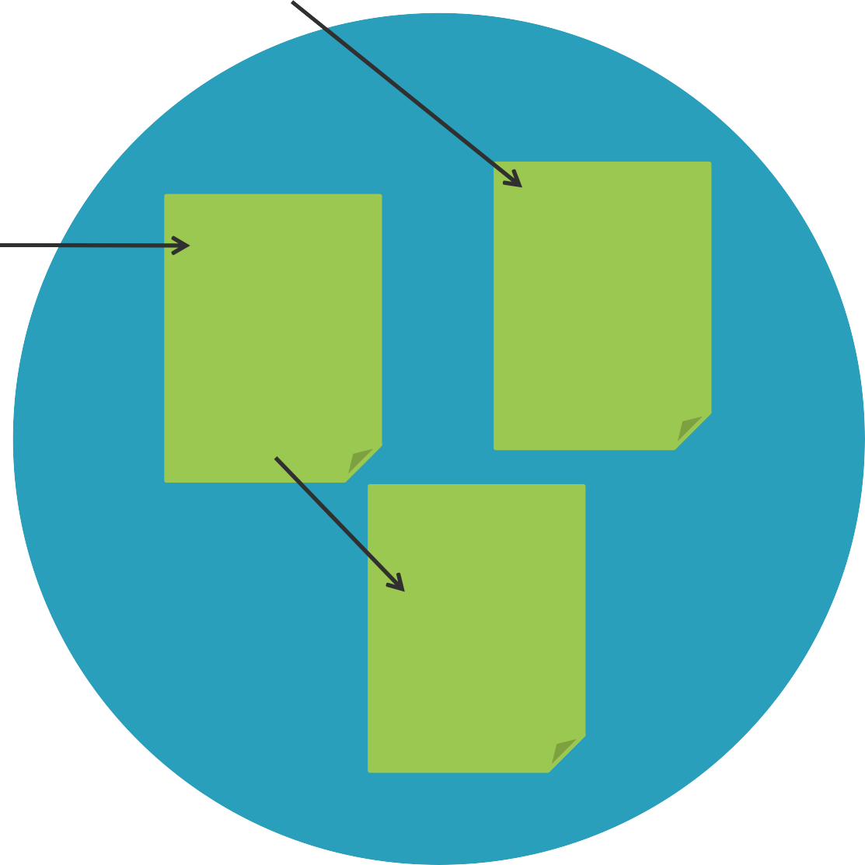
Protocols
HTTP
HTTPS (TLS) RMI/IIOP
Application
Application
Application

Slide 13
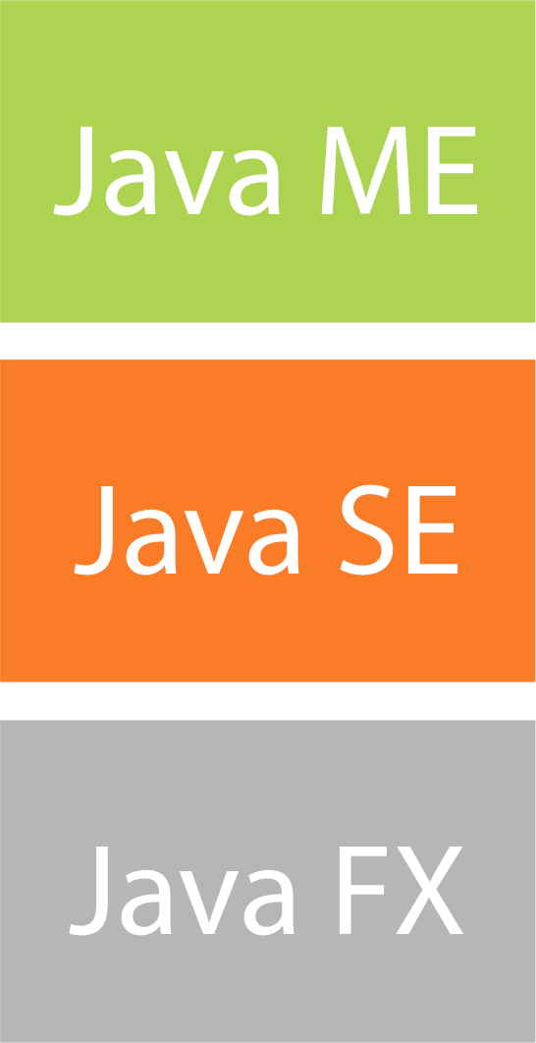
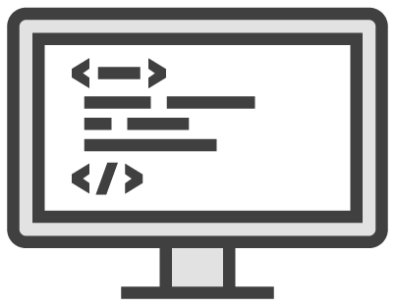
Clients
Web clients
Web applications REST / SOAP services
Mobile apps
B2B
Application
Application
Application

Slide 14
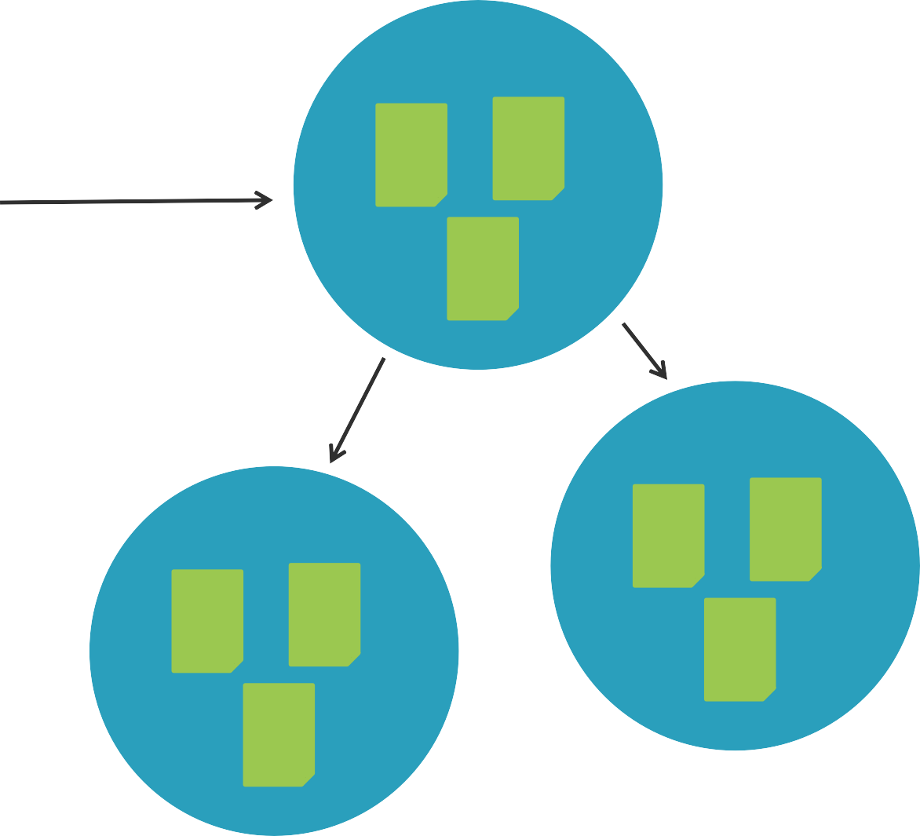
Distribution
Distributed application
Load balancing
Fail over Scalability Availability

Slide 15
Java EE Services
Java EE
Java SE

Slide 16
Java EE Services
Java EE
Java SE

Slide 17
Java EE Services
Web Tier
Common Tier
Interoperability Tier
Business Tier
Java SE

Slide 18
Business Tier Services
Web Tier
Common Tier
Interoperability Tier
Business Tier
Java SE

Slide 19
Business Tier Services
Web Tier
Common Tier
Interoperability Tier
Transactions
Batch
Persistence
Validation
Java SE

Slide 20
Web Tier Services
Web Tier
Common Tier
Interoperability Tier
Transactions
Batch
Persistence
Validation
Java SE

Slide 21
Web Tier Services
Web Pages
Expression Language
Servlets
Web Sockets
Common Tier
Interoperability Tier
Transactions Batch
Persistence Validation
Java SE

Slide 22
Interoperability Services
Web Pages
Expression Language
Servlets
Web Sockets
Common Tier
Interoperability Tier
Transactions Batch
Persistence Validation
Java SE

Slide 23
Interoperability Services
Web Pages
Expression Language
SOAP Services
REST Services
JSON
Messaging Email Connectors
Servlets
Web Sockets
Common Tier
Transactions Batch
Persistence Validation
Java SE

Slide 24
Common Services
Web Pages
Expression Language
SOAP Services
REST Services
JSON
Messaging Email Connectors
Servlets
Web Sockets
Common Tier
Transactions Batch
Persistence Validation
Java SE

Slide 25
Common Services
Injection
Web Pages
Expression Language
SOAP Services
REST Services
JSON
Messaging Email Connectors
Interception
Servlets
Web Sockets
Security
Transactions Batch
Persistence Validation
Concurrency
Java SE

Slide 26
Java SE Services
Injection
Web Pages
Expression Language
SOAP Services
REST Services
JSON
Messaging Email Connectors
Interception
Servlets
Web Sockets
Security
Transactions Batch
Persistence Validation
Concurrency
Java SE

Slide 27
Java SE Services
Injection
Web Pages
Expression Language
SOAP Services
REST Services
JSON
Messaging Email Connectors
Interception
Servlets
Web Sockets
Security
Transactions Batch
Persistence Validation
Concurrency
DB access Directory XML Remote
Managmt
…

Slide 28
Overall Services Picture
Injection
Web Pages
Expression Language
SOAP Services
REST Services
JSON
Messaging Email Connectors
Interception
Servlets
Web Sockets
Security
Transactions Batch
Persistence Validation
Concurrency
DB access Directory XML Remote
Managmt
…

Slide 29
Modular
Injection
Web Pages
Expression Language
SOAP Services
REST Services
JSON
Messaging Email Connectors
Interception
Servlets
Web Sockets
Security
Transactions Batch
Persistence Validation
Concurrency
DB access Directory XML Remote
Managmt
…

Slide 30
Batch Application
Injection
Web Pages
Expression Language
SOAP Services
REST Services
JSON
Messaging Email Connectors
Interception
Servlets
Web Sockets
Security
Transactions Batch
Persistence Validation
Concurrency
DB access Directory XML Remote
Managmt
…

Slide 31
Web Application
Injection
Web Pages
Expression Language
SOAP Services
REST Services
JSON
Messaging Email Connectors
Interception
Servlets
Web Sockets
Security
Transactions Batch
Persistence Validation
Concurrency
DB access Directory XML Remote
Managmt
…

Slide 32
REST Application
Injection
Web Pages
Expression Language
SOAP Services
REST Services
JSON
Messaging Email Connectors
Interception
Servlets
Web Sockets
Security
Transactions Batch
Persistence Validation
Concurrency
DB access Directory XML Remote
Managmt
…

Slide 33
Concurrent Application
Injection
Web Pages
Expression Language
SOAP Services
REST Services
JSON
Messaging Email Connectors
Interception
Servlets
Web Sockets
Security
Transactions Batch
Persistence Validation
Concurrency
DB access Directory XML Remote
Managmt
…

Slide 34



Java EE in Action
Provider
Open source Commercial

Slide 35

Package components
Runtime provider Protocols
Summary
Services
Business tier, web tier…
Common to most tiers

